Slide 1
Assimilation, Pluralism, & the Persistence of Ethnic Cultures
HIS 206

Slide 2
The Dominant, White, Anglo-Saxon, Protestant Culture
Founding Fathers emphasized liberal ideology rather than ethnicity as basis of American national identity
Needed to distinguish themselves from British
Needed support of recent immigrants for Revolution
3 key elements: universal (though racially limited in practice), new, & future-oriented
Immigrants seen as threat when assumed to be unable to assimilate to U.S. ideals
Radicalism – Jacobins, Socialists, Communists, Anarchists, Terrorists, etc.
Religion – Catholics, Jews, Muslims, etc.
Race – Asians, Africans, etc.

Slide 3
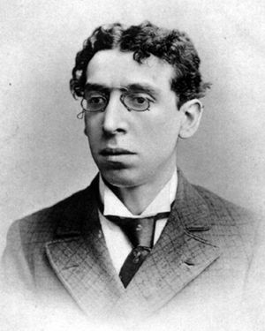
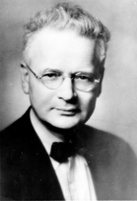
Assimilation or Pluralism?
“Melting Pot” concept expressed cosmopolitan nationalism in keeping with universal ideology
Assumed assimilation, but permitted retention of ethnic culture
Occasionally backed by argument that mixed strains better than pure breeds
Alternatives based on romantic nationalism
Assumed group ties were primordial; therefore, assimilation was impossible and/or undesirable
Nativism based on xenophobia and “scientific” racism & eugenics
Horace Kallen advocated cultural pluralism
Israel Zangwill
Horace Kallen

Slide 4
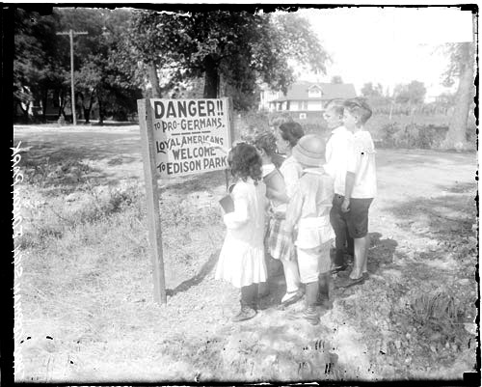
Americanization
3 phases of Americanization movement:
Pre-World War I
World War I
Post-World War I
2 strains:
Nervously nationalistic – D.A.R., National Civic League
Positively paternalistic – settlement houses, Social Gospel
World War I (1914-1918) shocked native-born with signs of immigrants’ lingering loyalties
Led to intensification of efforts (inc. fed. gov’t) to achieve “100 Percent Americanism”
Post-WWI intensity continued, fueled by Red Scare
Anti-German Sentiment During WWI

Slide 5
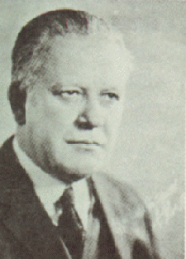
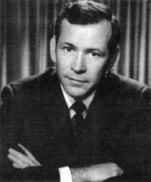
Chicago School (1920s)
Robert Park, Ernest Burgess, William Thomas et al based their work on German conflict theorists
Peasant societies & families had become disorganized by industrialization, leading to personal demoralization
In U.S., immigrants reorganized ethnic group parishes & mutual aid societies, ironically hastening assimilation
Race relations cycle: contact, competition, accommodation, assimilation
Marcus Hansen’s Law suggested interest in ethnic identity often re-emerged in 3rd generation
Oscar Handlin’s The Uprooted (1951) described immigrants as dislocated peasants bewildered by modern industrial life
Robert E. Park
Oscar Handlin

Slide 6
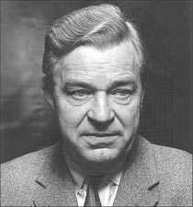
Critiquing American Ideology
1940s-50s saw upsurge of interest in American ideology in reaction to Nazi & Soviet regimes
Gunnar Myrdal’s The American Dilemma (1944) described gap between American ideal of equality & reality of minority treatment
Ruby Jo Reeves Kennedy & Will Herberg suggested “triple melting pot” – Protestant, Catholic, Jewish
John Higham’s Strangers in the Land (1955) argued nativism ran in cycles, and melting pot partially worked
Bruising civil rights struggle created intense disillusionment
“Black Power” movement embraced separatist black nationalist ideology & goals, spawning similar movements among other minorities
White, working-class ethnics resented “special treatment” of minorities & asserted their own separate identities
Gunnar Myrdal

Slide 7
Assimilation Attacked
New Ethnicity scholars saw American ideology as a sham rather than as an unfulfilled ideal
Milton Gordon’s Assimilation in American Life (1964) argued structural assimilation would eventually take place, but for now U.S. divided into “ethclasses”
Nathan Glazer & Daniel Moynihan’s Beyond the Melting Pot (1963) said melting pot never happened beyond core group
Michael Novak’s The Rise of the Unmeltable Ethnics (1972) attacked WASP culture & described PIGS as subservient, but sullen & resentful
New Social History also denied or minimized assimilation
Herbert Gutman’s Work, Culture & Society in Industrializing America (1976) argued immigrants brought pre-modern work habits & created diverse ethnic subcultures
John Bodnar’s The Transplanted (1986) argued immigrants created “culture of everyday life” in response to industrialization

Slide 8
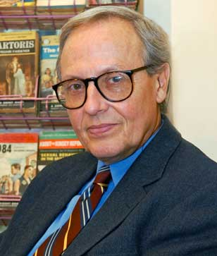
Recent Approaches
Recent scholars have emphasized cultural construction of ethnicity, grounded in real-life experiences
Werner Sollor’s The Invention of Ethnicity (1989)
Kathleen Conzen et al’s article (1992)
Labor historians describe inter-ethnic assimilation through labor unions
Gary Gerstle, Working-Class Americanism (1989)
James Barrett, “Americanization from the Bottom Up” (1992)
Whiteness Studies focuses on creation of white (Euro-American) identity
David Roediger, The Wages of Whiteness (1991)
Matthew Frye Jacobsen, Whiteness of a Different Color (1998)
Werner Sollors
Kathleen Conzen

Slide 9
Return to the Melting Pot
American national identity based on a commitment to shared political ideals that transcends ethnic boundaries, despite racial boundaries of the past
Melting pot ideal rejects assimilation v. cultural pluralism as false dichotomy
Lawrence Fuch’s American Kaleidoscope (1990) describes voluntary pluralism – can embrace ethnic group identity & Americans civic ideals simultaneously
Herbert Gans argues for “symbolic ethnicity” - most people still feel need for ethnic identity, but express it in voluntary, individualistic & intermittent ways
Racial minorities have strongest identities
experienced the most hostility
Have the hardest time blending in due to physical distinctives

